Slide 1
GST ANNUAL RETURN
DATE: 25th November’2023
PRESENTED BY: RAMAN JUYAL, SHWETA DANGWAL
MENTORED BY: VERENDRA KALRA

Slide 2
Topic Description
Applicability & Filing of GSTR-9 & GSTR-9C
vkalra.com

Slide 3
Introduction to GSTR 9
.
As per section 44 of the CGST Act read with rule 80 (1) of the CGST Rules:
Every registered person whose aggregate turnover exceeds two crore rupees shall furnish annual return in GSTR-9, other than the following
• an Input Service Distributor,
• a person paying tax under section 51 or section 52 (TDS deductor & TCS collector),
• a casual taxable person
• a non-resident taxable person
shall furnish annual return in Form GSTR-9 on or before the 31st day of December of the succeeding financial year.
vkalra.com

Slide 4
Key Points
.
A person having multiple registrations exceeding turnover limit for filing GSTR-9 should also file a Nil Annual Return for those GSTIN which do not have any transactions during the year.
Registered person who has opted in or opted out of composition scheme is required to file both Form GSTR-9 (If turnover of the respective financial year exceeds Rs. 2 Cr.) & GSTR-4 (Mandatory) for the relevant period.
Form GSTR-9 does not allow for any revision after filing.
The declaration of the information in the Annual returns has multiple implications. Any incorrect information can attract tax demands, interest and penalties on the same.
vkalra.com

Slide 5
Key Points
Liability identified during filing Annual Return can be deposited with Government using Form DRC-03.
Failure to submit the annual return may result in notice to defaulters & also late fee of Rs.200 per day (Rs.100 for CGST & Rs.100 for SGST) for delayed filing subject to a maximum amount of 0.50% (0.25% for SGST & 0.25% for CGST) of the turnover in the State or Union Territory.
vkalra.com

Slide 6
Analysis of Form GSTR-9
.
GSTR-9 consists of following parts as listed below :
PART | ITEMS
I | Basic Details (i.e Financial Year, GSTIN, Legal name & Trade name)
II | Details of Outward and inward supplies made during the financial year
III | Details of ITC for the financial year
IV | Details of tax paid as declared in returns filed during the financial year
V | Particulars of the transactions for the FY declared in returns of next FY till the specified period.
VI | Other Information
vkalra.com

Slide 7
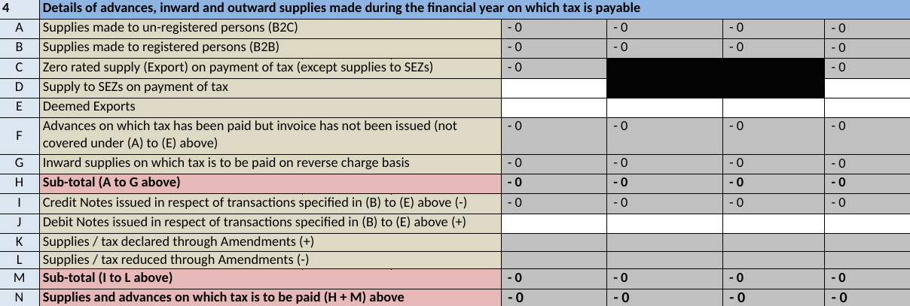
PART–II: Table No. 4
.
Mandatory Field
vkalra.com

Slide 8
Adjustment in case of Supply
The registered person has to examine the particulars of the payout against the missed supply or amendment carried out. There can be 2 scenarios, which are as follows :
If the payment for a transaction was made through Form GSTR-3B or through Form GST DRC-03 for the reporting Financial Year, then the same will be reported in Table no.10 & Table No. 4 of the Form GSTR-9.
In 1st case, where the payment is made through Form GSTR-3B of the next Financial Year up to the specified date then those transactions will be reported in Table No. 10.
In 2nd scenario, the taxes have not been paid against the transactions and the registered person desires to pay the tax along with interest in Form GSTR-9, then the said transaction has to be reported in Table 4 and the payment will be made through form DRC-03.
*According to Section 39(9) rectification of any omission or incorrect particulars made in Form GSTR-3B of the financial year shall be allowed in the relevant return or the return filed up to 30th November of the next financial year or the date of furnishing annual return for the said financial year, whichever is earlier
.
vkalra.com

Slide 9
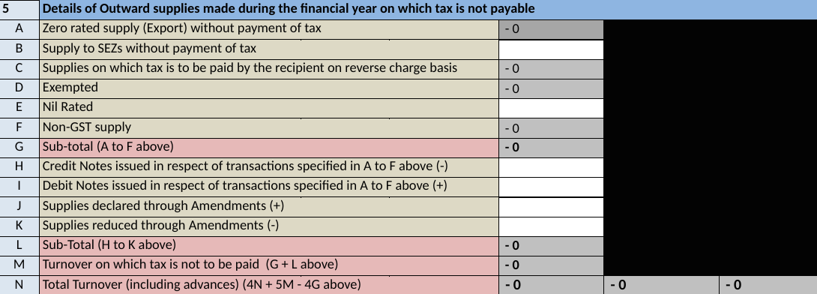
PART–II: Table No. 5
.
Optional Field
Nil rated & Exempted supply can be shown in Exempted supply only
vkalra.com

Slide 10
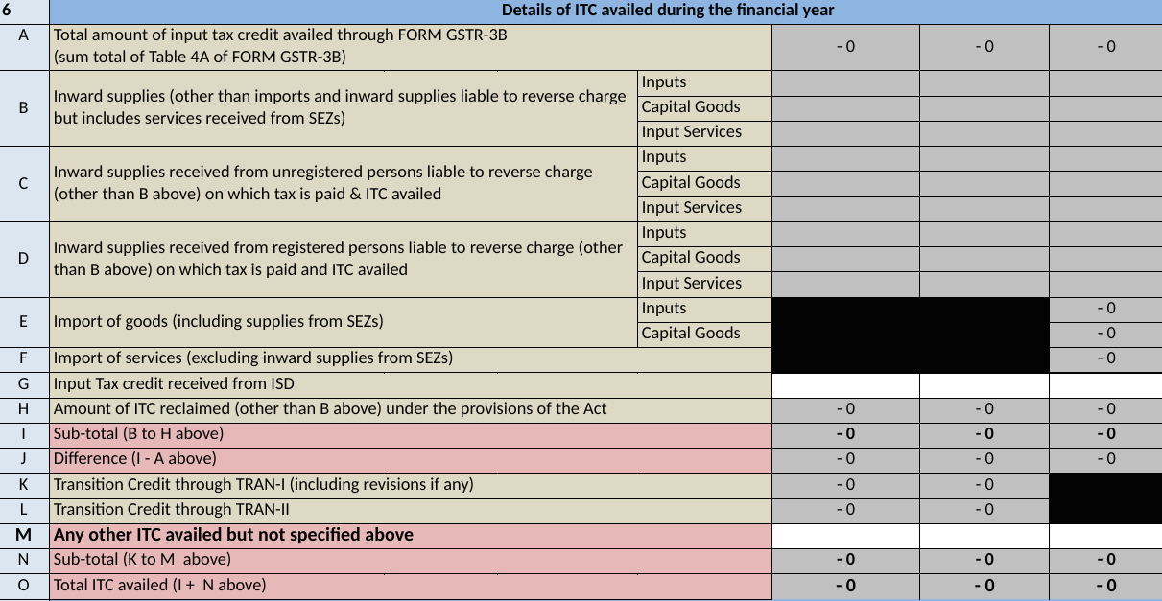
PART–II: Table No. 6
.
Inward supply received from un-registered persons liable to reverse charge (Table 6C) and from registered person (Table 6D) can be declared under Table 6D only.
vkalra.com

Slide 11
For availing ITC against reversal under rule 37
If an ITC is reversed on account of non-payment to a vendor within one hundred and eighty days, when payment is made, the Registered Person is eligible to reclaim the credit at perpetual. Such amount, of re-credits are to be reported in Table 6H.
For difference (if any) reflecting in Table 6J
Ideally, the difference in Table 6J should be nil. This is for the reason, that the amount disclosed in Table 6A is auto-populated from GSTR-3B. Further, the amount disclosed in Table 6B to 6H is merely the classification of ITC availed in Form GSTR-3B. If the amount is not zero and a tax liability arises, then it has to be discharged through Form GST DRC-03, if not rectified in the next financial year till specified date.
Optional Field
Bifurcation of Input services can be shown along with Input goods.
Mandatory Field
Bifurcation of Capital Goods is mandatory.
.
vkalra.com

Slide 12
PART–III: Table No. 7
.
Either amounts can be reported in Table No. 7A to 7E, or the entire amount can be reported under Table 7H.
ITC left to be reversed in Form GSTR-3B filed for the reporting financial year and reported in Form GSTR-3B filed for the subsequent financial year, would be reported in Table-12 of Form GSTR-9
vkalra.com

Slide 13
PART–III: Table No. 8
.
vkalra.com

Slide 14
For ITC not reconciled (Entry 8D)
Consequences if difference is negative
Rule 36 (4)
Rule 36 sub-section 4 states that a taxpayer can claim ITC only if the same appears in their GSTR-2B.
However, if ITC is availed in excess, of what is reflecting in GSTR-2B then it may result in notice to taxpayer & also, excess ITC availed should be reversed & tax to be paid on the same.
Note- The taxpayer would be required to pay the liability in cash if reversing it in annual return, despite having eligible ITC on payment of taxes to its supplier. Moreover, the taxpayer would not be able to claim refund of excess tax paid by them due to default of the suppliers.
vkalra.com

Slide 15
PART–IV: Table No. 9
Difference in Tax Payable & Taxes Paid
If the difference is positive, the shortfall of tax needs to be paid off while filing GSTR-3B of the subsequent month or by filing DRC-03.
However, if difference is negative, it indicates that liability of previous financial year is paid in current financial year
vkalra.com

Slide 16
PART–V: Table No.10,11,12,13 & 14
vkalra.com

Slide 17
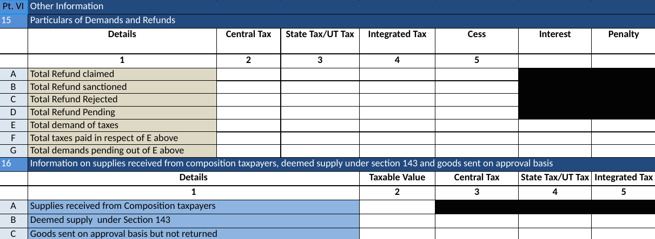
PART–VI: Table No.15 & 16
*Note- Table no. 15 & 16 are optional
vkalra.com

Slide 18
PART–VI: Table No.17,18 & 19
*Note- Table 18 is optional
vkalra.com

Slide 19
Introduction to GSTR-9C
Every registered person under GST whose turnover during a financial year exceeds the prescribed limit of Rs.5 crore must prepare the reconciliation statement in Form GSTR-9C.
GSTR-9C is a statement of reconciliation between:
the Annual Returns in GSTR-9 filed for a FY, and
the figures as per the audited annual Financial Statements of the taxpayer.
It will consist of gross and taxable turnover as per the Books reconciled with the respective figures as per the consolidation of all the GST returns for an FY.
Hence, any differences arising from this reconciliation exercise will be reported here, along with the reasons for the same and then certified by the taxpayer themselves.
vkalra.com

Slide 20
Analysis of Form GSTR-9C
GSTR-9C consists of the following parts as listed below:
PART | ITEMS
I | Basic Details (i.e. FY, GSTIN, Legal Name & Trade Name)
II | Reconciliation of turnover declared in audited Annual Financial Statement with turnover declared in Annual Return (GSTR9)
III | Reconciliation of tax paid
IV | Reconciliation of Input Tax Credit (ITC)
V | Auditor's recommendation on additional Liability due to non-reconciliation
vkalra.com

Slide 21
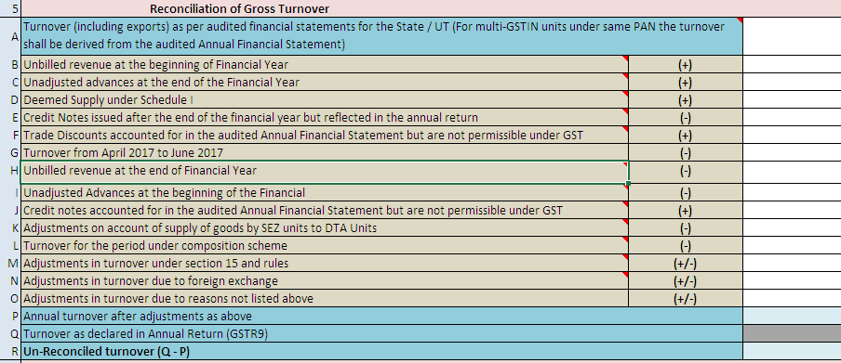
PART-II: Table No. 5
.
Note- Bifurcation in Table 5B to 5N is optional and consolidated amount can be shown in Table 5O.
vkalra.com

Slide 22
Key Points in Table 5 :
Table 5A- The turnover as per the audited Annual Financial Statement shall be declared here.
Table 5B- Unbilled revenue which was recorded in the books of accounts on the basis of accrual system of accounting in the last financial year and was carried forward to the current financial year shall be declared here.
Table 5C-Value of all advances for which GST has been paid but the same has not been recognized as revenue in the audited Annual Financial Statement shall be declared here.
Table 5D-Aggregate value of deemed supplies under Schedule I of the CGST Act, 2017 shall be declared here. Any deemed supply which is already part of the turnover in the audited Annual Financial Statement is not required to be included here.
vkalra.com

Slide 23
Table 5E- Aggregate value of credit notes which were issued after 31st of March for any supply accounted in the current financial year but such credit notes were reflected in the annual return (GSTR-9) shall be declared here.
Table 5F- Trade discounts which are accounted for in the audited Annual Financial Statement but on which GST was leviable (being not permissible) shall be declared here.
Table 5G- Turnover included in the audited Annual Financial Statement for April 2017 to June 2017 shall be declared here.
Table 5H- Unbilled revenue which was recorded in the books of accounts on the basis of accrual system of accounting during the current financial year, but GST was not payable on such revenue in the same financial year shall be declared here.
Table 5I- Value of all advances for which GST has not been paid but the same has been recognized as revenue in the audited Annual Financial Statement shall be declared here.
.
vkalra.com

Slide 24
Table 5J- Aggregate value of credit notes which have been accounted for in the audited Annual Financial Statement but were not admissible under Section 34 of the CGST Act shall be declared here.
Table 5K- Aggregate value of all goods supplied by SEZs to DTA units for which the DTA units have filed bill of entry shall be declared here.
Table 5L-There may be cases where registered persons might have opted out of the composition scheme during the current financial year. Their turnover as per the audited Annual Financial Statement would include turnover both as composition taxpayer as well as normal taxpayer. Therefore, the turnover for which GST was paid under the composition scheme shall be declared here.
Table 5M- There may be cases where the taxable value and the invoice value differ due to valuation principles under section 15 of the CGST Act, 2017 and rules thereunder. Therefore, any difference between the turnover reported in the Annual Return (GSTR 9) and turnover reported in the audited Annual Financial Statement due to difference in valuation of supplies shall be declared here.
.
vkalra.com

Slide 25
Table 5N- Any difference between the turnover reported in the Annual Return (GSTR9) and turnover reported in the audited Annual Financial Statement due to foreign exchange fluctuations shall be declared here.
Table 5O- Any difference between the turnover reported in the Annual Return (GSTR9) and turnover reported in the audited Annual Financial Statement due to reasons not listed above shall be declared here
Table 5Q- Annual turnover as declared in the Annual Return (GSTR 9) shall be declared here. This turnover may be derived from Sr. No. 5N, 10 and 11 of Annual Return (GSTR-9).
vkalra.com

Slide 26
PART-II: Table No. 6
.
Reasons for non-reconciliation between the annual turnover declared in the audited Annual Financial Statement and turnover as declared in the Annual Return (GSTR 9) shall be specified here.
vkalra.com

Slide 27
PART-II: Table No. 7 & 8
.
vkalra.com

Slide 28
Key Points in Table 7 & 8 :
The table provides for reconciliation of taxable turnover from the audited annual turnover after adjustments with the taxable turnover declared in annual return (GSTR-9).
Table 7A- Annual turnover as derived in Table 5P above would be auto-populated here.
Table 7B- Value of exempted, nil rated, non-GST and no-supply turnover shall be declared here. This shall be reported net of credit notes, debit notes and amendments if any.
Table 7C- Value of zero-rated supplies (including supplies to SEZs) on which tax is not paid shall be declared here. This shall be reported net of credit notes, debit notes and amendments if any.
vkalra.com

Slide 29
Table 7D- Value of reverse charge supplies on which tax is to be paid by the recipient shall be declared here. This shall be reported net of credit notes, debit notes and amendments if any.
Table 7E- The taxable turnover is derived as the difference between the annual turnover after adjustments declared in Table 7A above and the sum of all supplies (exempted, non-GST, reverse charge etc.) declared in Table 7B, 7C and 7D above.
Table 7F- Taxable turnover as declared in Table (4N – 4G) + (10-11) of the Annual Return (GSTR9) shall be declared here.
Table 8 : Reasons for non-reconciliation between adjusted annual taxable turnover as derived from Table 7E above and the taxable turnover declared in Table 7F shall be specified here.
vkalra.com

Slide 30
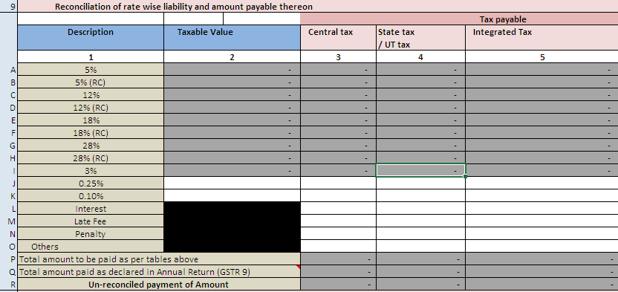
PART-III: Table No. 9 :
vkalra.com

Slide 31
Key Points in Table 9 :
The table provides for reconciliation of tax paid as per reconciliation statement and amount of tax paid as declared in Annual Return (GSTR 9). Under the head labelled ―RC‖, supplies where tax was paid on reverse charge basis by the recipient (i.e. the person for whom reconciliation statement has been prepared) shall be declared.
Table 9P- The total amount to be paid as per liability declared in Table 9A to 9O is auto populated here.
Table 9Q- The amount payable as declared in Table 9 of the Annual Return (GSTR9) shall be declared here. It should also contain any differential tax paid on Table 10 or 11 of the Annual Return (GSTR9)
vkalra.com

Slide 32
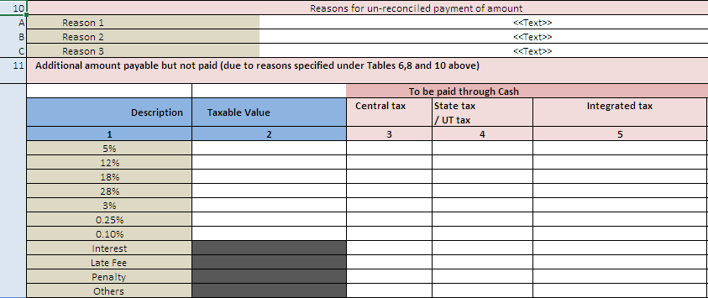
PART-III: Table No. 10 & 11
vkalra.com

Slide 33
Table 10 :
Reasons for non-reconciliation between payable / liability declared in Table 9P above and the amount payable in Table 9Q shall be specified here
Table 11 :
Any amount which is payable due to reasons specified under Table 6, 8 and 10 above shall be declared here.
vkalra.com

Slide 34
PART-IV: Table No. 12 & 13
vkalra.com

Slide 35
Key Points in Table 12 :
Table 12 A- ITC availed (after reversals) as per the audited Annual Financial Statement shall be declared here. There may be cases where multiple GSTINs (State-wise) registrations exist on the same PAN. This is common for persons / entities with presence over multiple States. Such persons / entities, will have to internally derive their ITC for each individual GSTIN and declare the same here. It may be noted that reference to audited Annual Financial Statement includes reference to books of accounts in case of persons / entities having presence over multiple States.
Table 12 B- Any ITC which was booked in the audited Annual Financial Statement of earlier financial year(s) but availed in the ITC ledger in the financial year for which the reconciliation statement is being filed for shall be declared here
vkalra.com

Slide 36
Table 12 C- Any ITC which has been booked in the audited Annual Financial Statement of the current financial year but the same has not been credited to the ITC ledger for the said financial year shall be declared here.
Table 12 D- ITC availed as per audited Annual Financial Statement or books of accounts as derived from values declared in Table 12A, 12B and 12C above will be auto populated here.
Table 12 E- Net ITC available for utilization as declared in Table 7J of Annual Return (GSTR9) shall be declared here.
Table 13: Reasons for non-reconciliation of ITC as per audited Annual Financial Statement or books of account (Table 12D) and the net ITC (Table 7J) availed in the Annual Return (GSTR9) shall be specified here.
vkalra.com

Slide 37
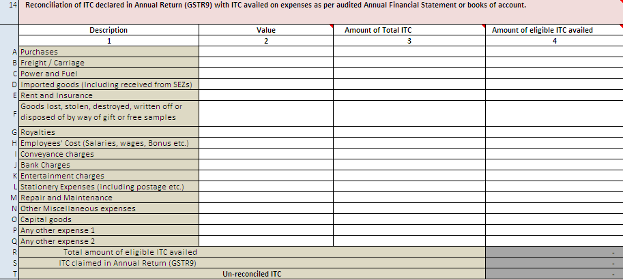
PART-IV: Table No. 14
.
*Note: Table 14 is optional
vkalra.com

Slide 38
PART-IV: Table No. 15 & 16 :
vkalra.com

Slide 39
Table No. 15
Reasons for non-reconciliation between ITC availed on the various expenses declared in Table 14R and ITC declared in Table 14S shall be specified here.
Table No. 16
Any amount which is payable due to reasons specified in Table 13 and 15 above shall be declared here .
vkalra.com

Slide 40
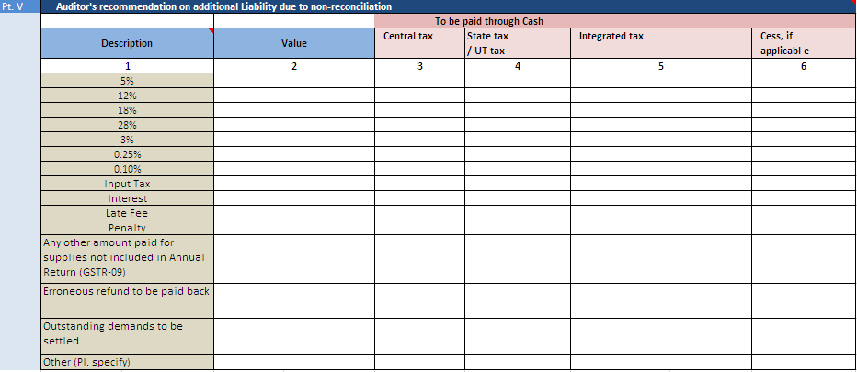
PART-V
vkalra.com

Slide 41
Thank You
3rd Floor, MJ Tower,
55, Rajpur Road,
Dehradun - 248001
T: +91.135.2743283
+91.135.2747084
W: vkalra.com
Follow us on

